Slide 1
Binary Search Tree (BST)
(Properties, insertion, sorting, traversals, min, max, search, balancing)

Slide 2
Overview
Binary trees Ch 12.2–3
Trees Ch 10.4, 12.1

Slide 3
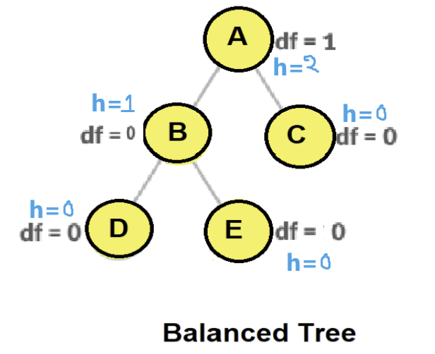
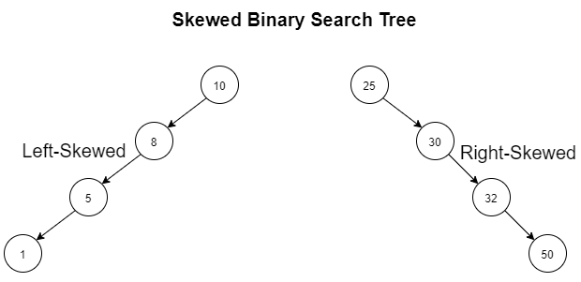
Binary-search-tree (BST)
Powerful data structures for dynamic-set operations
E.g., dictionaries or priority queues
Basic operations (insert, delete, search) take time proportional to height of tree, O(h)
  For balanced BST with n nodes: O(h)= O(logn)→ operations take O(log n).
  For skewed tree/unbalanced BST with n nodes: O(h)=O(n) → operations take O(n).
Binary trees Ch 12.2–3

Slide 4
Binary-search-tree (BST)
In practice, more advanced binary trees required to keep trees balanced over time (not skewed),
e.g. B-trees, red-black-trees
For BST, nodes will have style2 [Discussed in previous lecture (BT basics)]
  key or value
  parent
  left child
  right child
Binary trees Ch 12.2–3

Slide 5
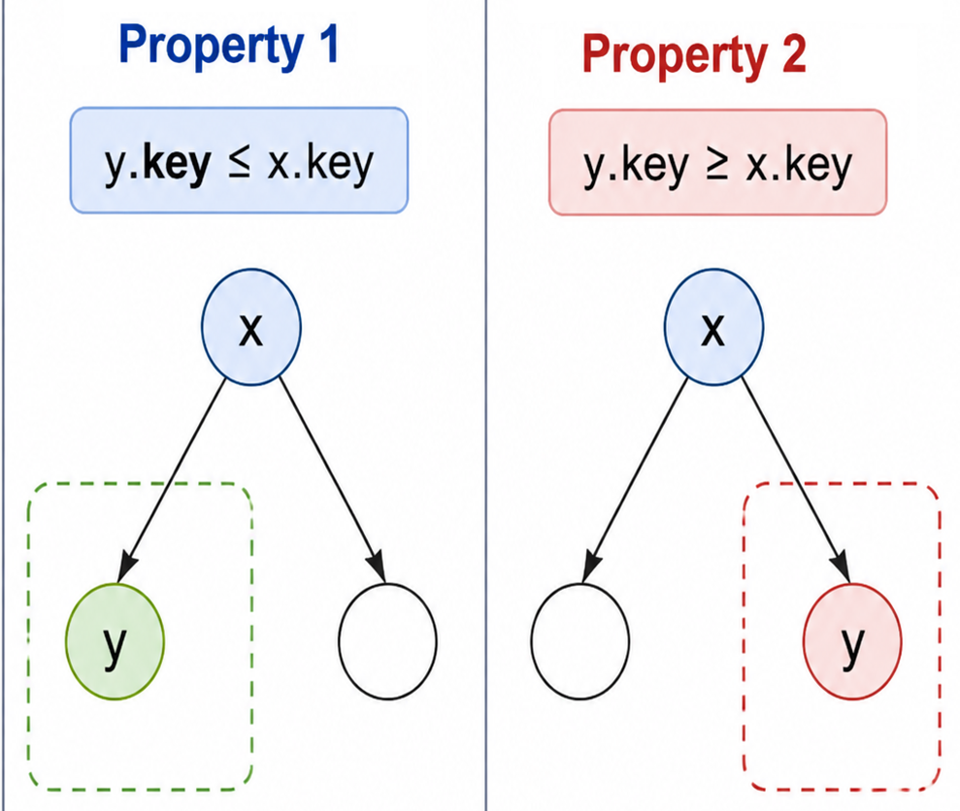
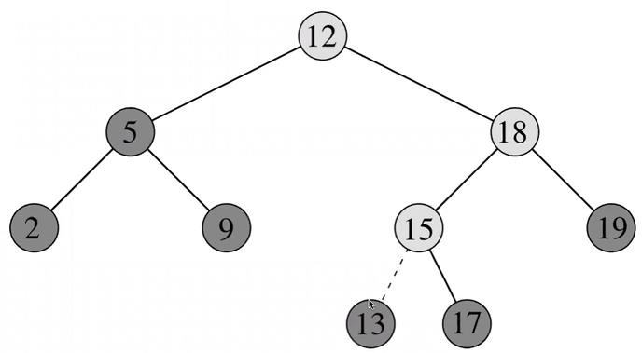
Binary-search-tree property (BSTP) (Important!!)
Binary tree with the following property is called BST:
If for any two elements x and y the following holds: -
Property1: If y is in the left subtree of x, then:
  y.key ≤ x.key
Property2: If y is in the right subtree of x, then
  y.key ≥ x.key
Binary trees Ch 12.2–3

Slide 6
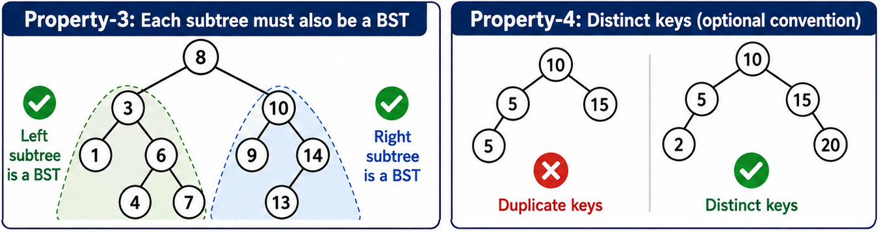
Binary-search-tree property (BSTP) (Important!!)
Binary tree with the following property is called BST:
Property 3: The left and right subtree each must also be a binary search tree.
Property 4:Each node must have a distinct key, meaning duplicate values are not allowed, though this is an optional property.
Binary trees Ch 12.2–3

Slide 7
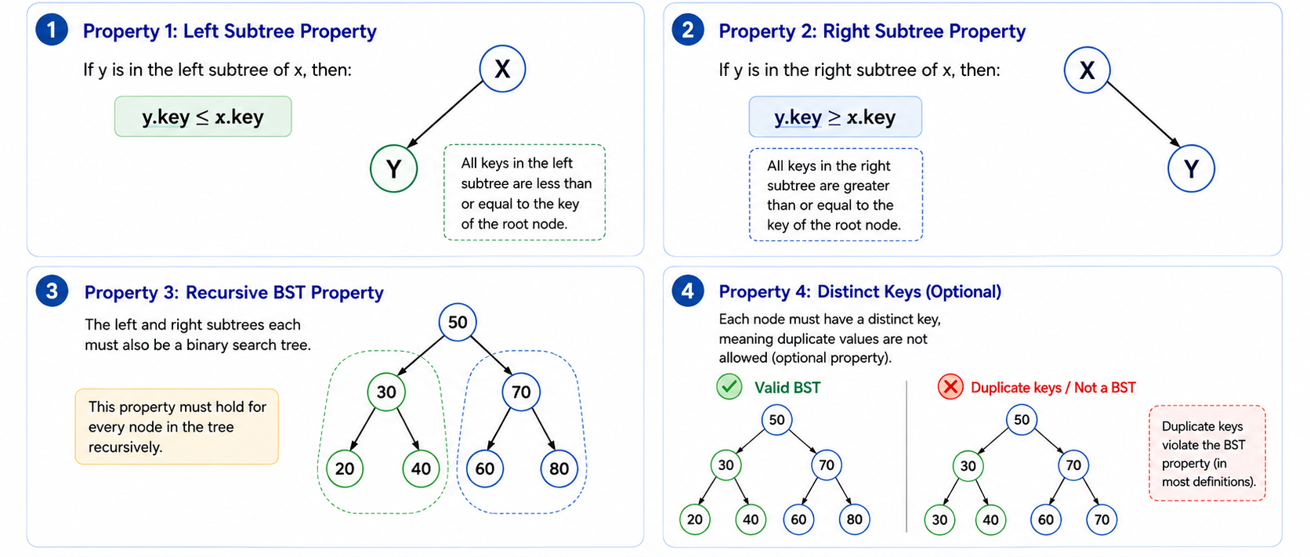
Binary-search-tree property (BSTP)
Binary trees Ch 12.2–3

Slide 8
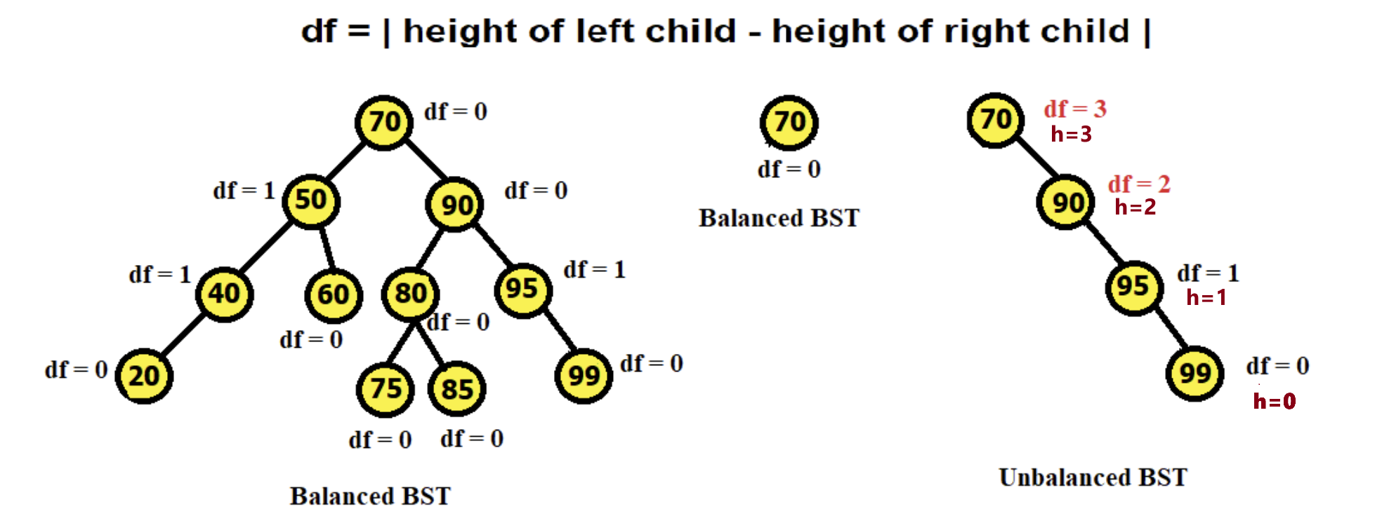
Goal of Using a BST
The goal of a BST is to search elements efficiently in O(h) time.
In a balanced BST, h=O(logn), so searching takes O(log n).
In an unbalanced/skewed BST, h=O(n), so, searching may take O(n).
Therefore, keeping the tree balanced is important for maintaining efficiency.
Always start checking from leaf nodes
When df>1,
say not balanced and STOP
(df=0, 1 acceptable)
If left or right subtree is missing,
consider the height of that subtree to be -1
Binary trees Ch 12.2–3

Slide 9
Maintaining Efficiency in BSTs (Importance of Balanced BST )
Always work with balanced BSTs to ensure optimal performance.
  In balanced BST,
    Insert, delete, search → O(h)→O(logn)
After insert or delete operations, height of BST might change,
check if the BST has become unbalanced.
  If unbalanced, rebalance the BST to restore efficiency.

Slide 10
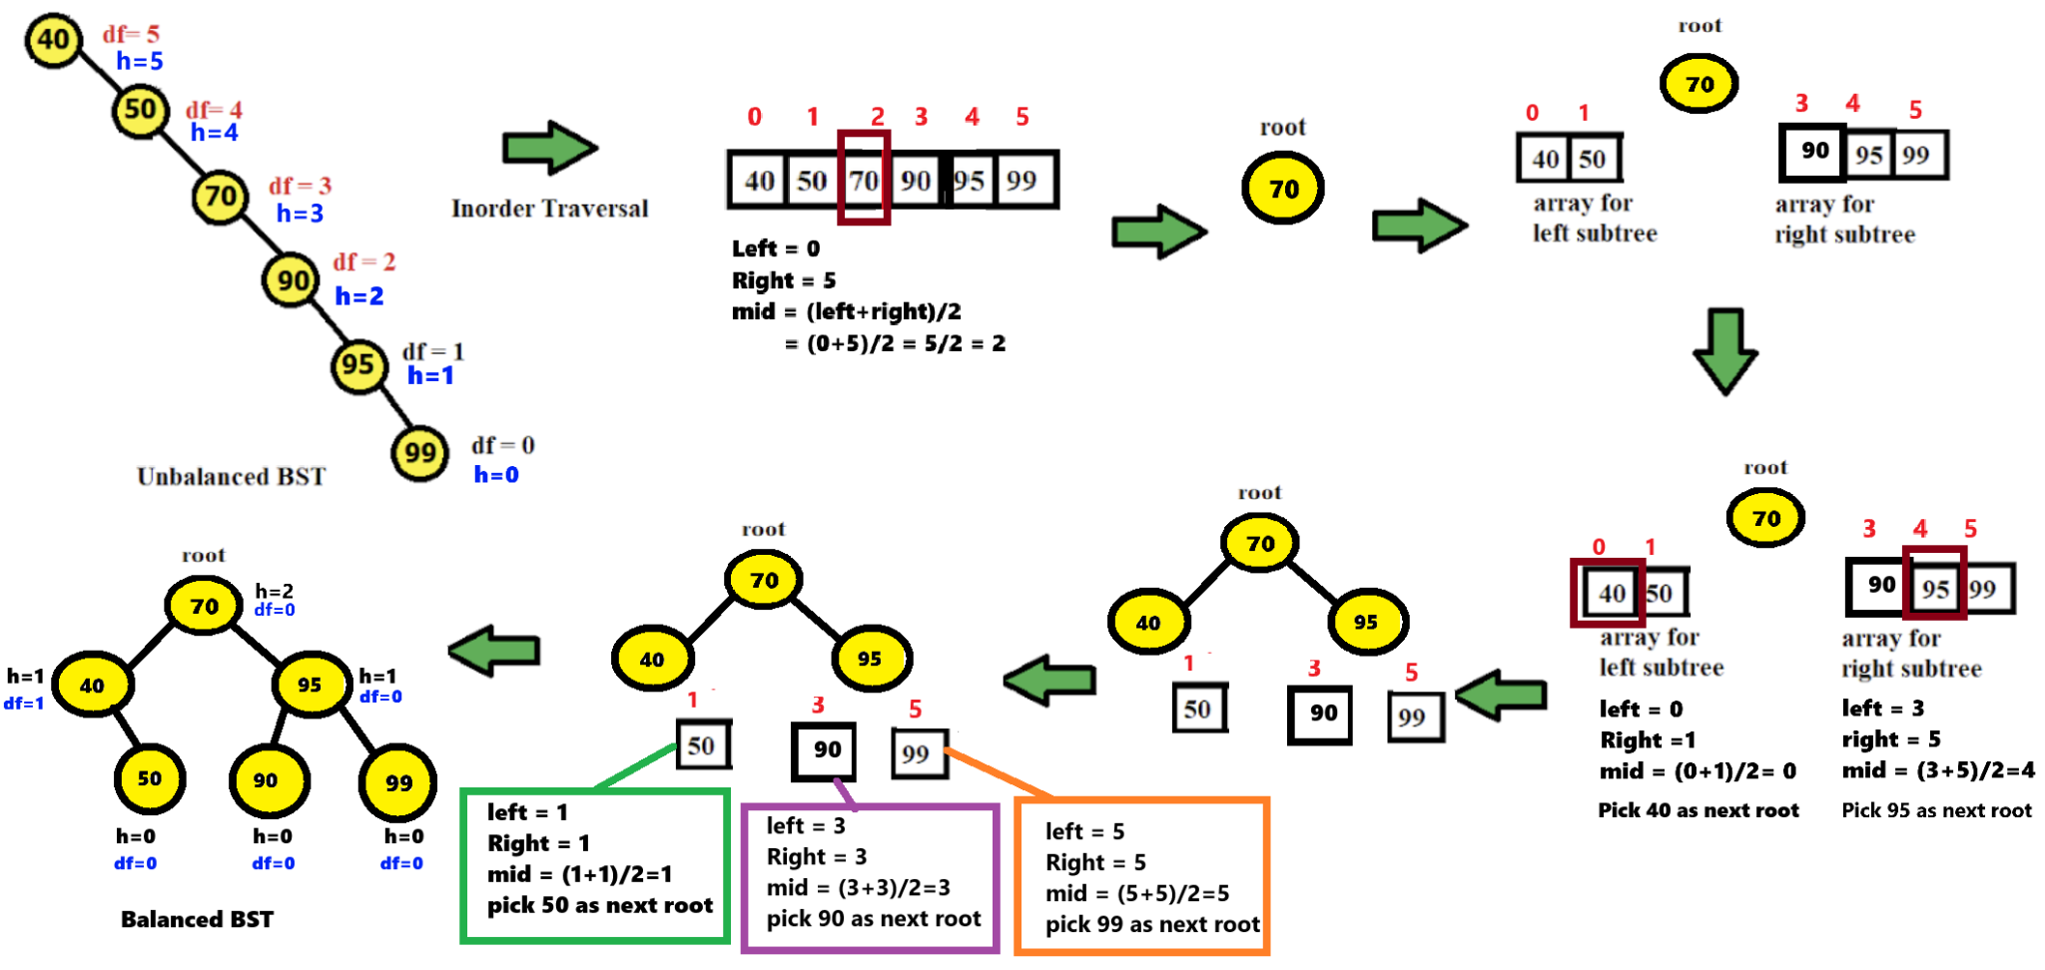
Converting an Unbalanced BST into a Balanced BST (Important!!)

Slide 11
Converting an Unbalanced BST into a Balanced BST
Step 1: Traverse and Store Data:
perform Inorder Traversal → Store BST elements in ascending array.
Step 2: Reconstruct the BST: Choose the middle element using the current index bounds:
  Compute mid = (left + right) // 2.
  Create the root from arr[mid].
  The left subtree uses the subarray from left to mid - 1.
  The right subtree uses the subarray from mid + 1 to right.
Step 3: Recursive Subtree Construction
  Base case: if left > right, return None.
  Recursively build:
    root.left = sortedArrayToBSTRecur(arr, left, mid - 1)
    root.right = sortedArrayToBSTRecur(arr, mid + 1, right)
  Repeat until all ranges are exhausted.
This process ensures the BST becomes balanced with optimal height.

Slide 12
Converting an Unbalanced BST into a Balanced BST
// Method to convert a sorted array to a balanced BST using recursion
ALGORITHM sortedArrayToBSTRecur(arr, left, right)
IF left > right THEN
RETURN null
// Find the middle element
mid <- (right + left) / 2
// Create the root node
root <- new TNode(arr[mid])
// Recursively create the left and right subtrees
root.left <- sortedArrayToBSTRecur(arr, left, mid - 1)
root.right <- sortedArrayToBSTRecur(arr, mid + 1, right)
RETURN root
_____________________________________________________________________________________________
ALGORITHM inorder_traversal(root) # In-order Traversal (Left, Root, Right)
IF root is not None THEN
CALL inorder_traversal(root.left)
PRINT root.val
CALL inorder_traversal(root.right)
_____________________________________________________________________________________________
arr <- [40, 50, 70, 90, 95, 99]
root <- sortedArrayToBSTRecur(arr, left = 0, right = length(arr) - 1)
CALL inorder_traversal(root)

Slide 13
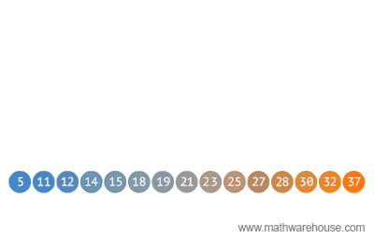
Sorted Array to Binary Search Tree

Slide 14
Insertion
We have some new node z with z.key = v to insert into tree
Always insert as a new leaf
Must maintain binary-search-tree property (BSTP)
  insert to the right of all nodes with larger key
  insert to the left of all nodes with smaller key
Binary trees Ch 12.2–3

Slide 15
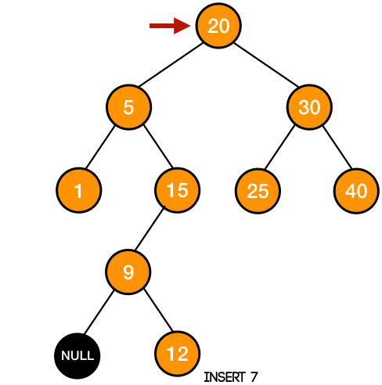
Insertion 7
Binary trees Ch 12.2–3

Slide 16
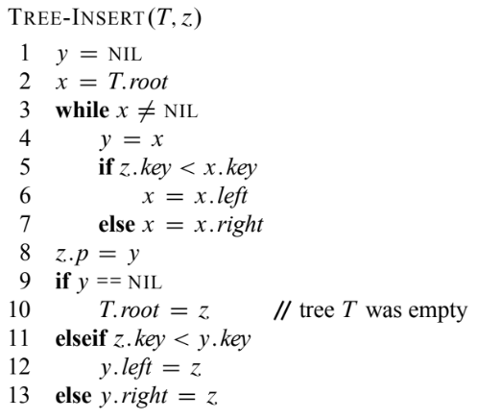
Insertion (code explanation)
y is parent of node we currently inspect
While loop descends through tree moving into correct subtree at each step
Last part links node and parent
Binary trees Ch 12.2–3

Slide 17
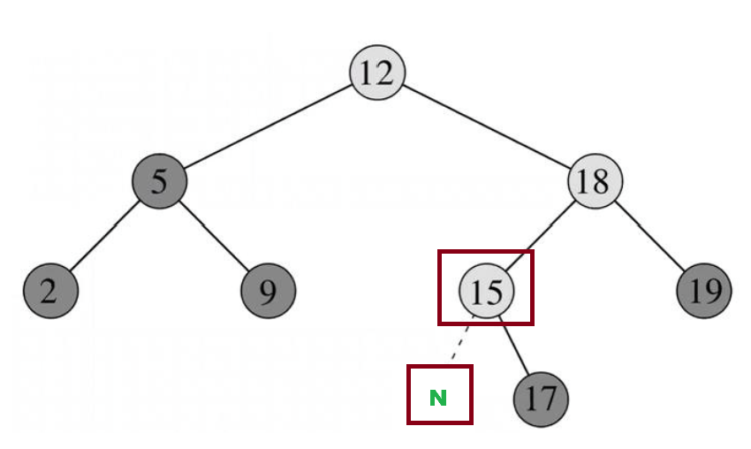
Insertion (code explanation)
Insert 13
ALGORITHM insert(root, key)
new_node <- TNode(key) # z
# Find the parent node to attach the new node
parent <- None # Tracks the parent node y
current <- root # Start from the root x
WHILE current is not None DO # finding parent
parent <- current
IF key < current.val THEN # Go left
current <- current.left
ELSE IF key > current.val THEN # Go right
current <- current.right
# Set the parent of the new node
new_node.parent <- parent
# Attach the new node to the left or right of the parent
IF parent is None THEN # If tree is empty, make new_node the root
root <- new_node
ELSE IF key < parent.val THEN # Attach new_node to the left of the parent
parent.left <- new_node
ELSE # Attach new_node to the right of the parent
parent.right <- new_node
RETURN root

Slide 18
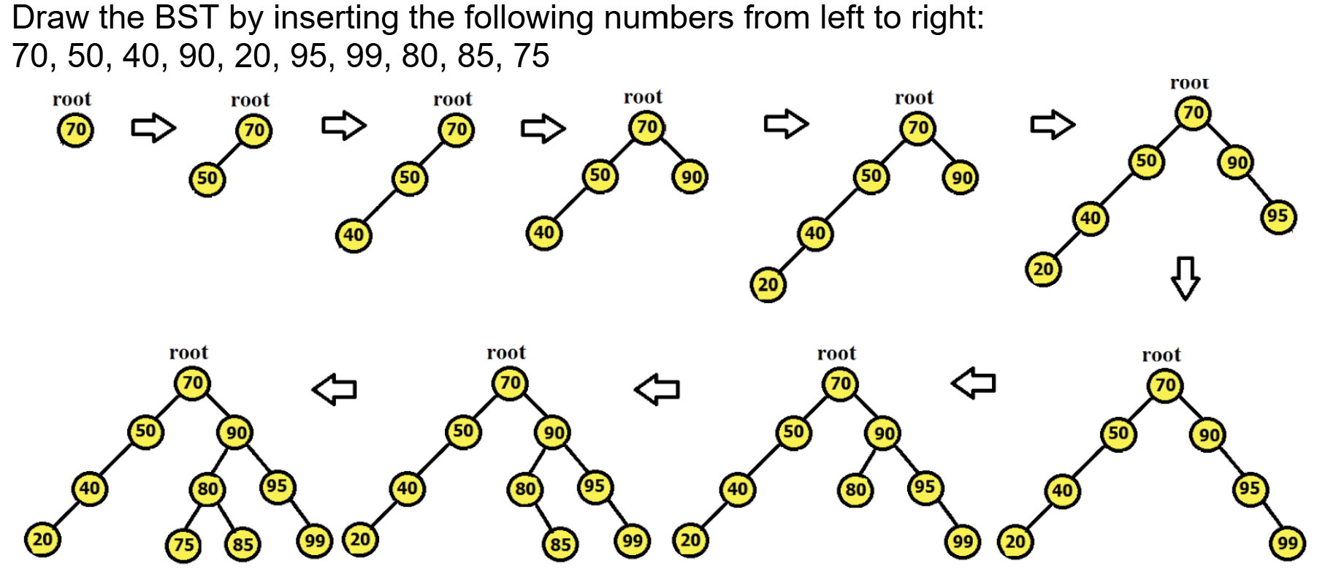
BST creation using insertion
(Process of creating a BST from a Random array)
Binary trees Ch 12.2–3

Slide 19
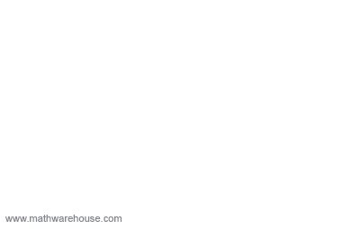
BST creation using insertion
Values to be inserted: 21 28 14 32 25 18 11 30 19 15
Binary trees Ch 12.2–3

Slide 20
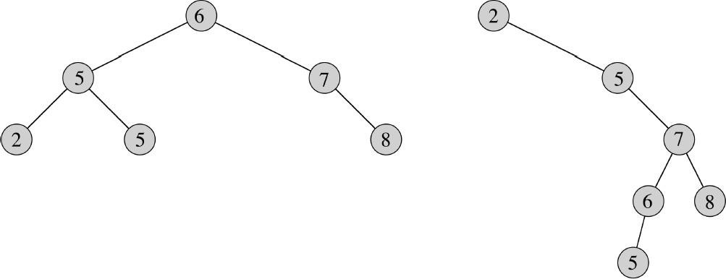
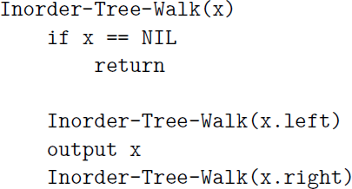
Inorder tree walk
Start at the root and recursively process: Left → Root → Right.
Visits nodes between their left and right subtrees.
In a BST, this prints all keys in ascending order.
Time complexity:
  Each node is visited exactly once
  A single operation is performed
  Thus, time complexity will be O(n).
Binary trees Ch 12.2–3

Slide 21
Tree walk (Pre-order and post-order walks)
  Pre-order: output each node before visiting left, then right subtree (Root, Left, Right)
  Post-order: visit left, then right subtree, then output node (Left, Right, Root)
  Time complexity: We visit each node exactly once and
  perform a single operation, thus time complexity will be O(n).
Binary trees Ch 12.2–3

Slide 22
BST Traversal (Important)
In-order traversal generates ASCENDING Ordered values
  (Left root right)
Reverse In-order traversal generates DESCENDING Ordered values
  (Right root Left)
Binary trees Ch 12.2–3

Slide 23
Tree Sort
Tree sort is a sorting algorithm that is based on Binary Search Tree data structure.
It first creates a binary search tree from the elements of the input list or array
Then performs an inorder traversal on the created binary search tree to get the elements in sorted order.
Algorithm:
Step 1: Take the elements input in an array
Step 2: Create a Binary search tree by inserting data items from the array into the binary search tree.
Step 3: Perform in-order traversal on the tree to get the elements in sorted order. (Ascending)
Binary trees Ch 12.2–3

Slide 24
BST creation using insertion
Step01: Take the elements input in an array.
[this is a regular array, not a binary tree representation]
(70, 50, 40, 90, 20, 95, 99, 80, 85, 75
0 1 2 3 4 5 6 7 8 9
Binary trees Ch 12.2–3

Slide 25
BST creation using insertion
Step02: Create a Binary search tree by inserting data items from the array into
the binary search tree.
(70, 50, 40, 90, 20, 95, 99, 80, 85, 75)
0 1 2 3 4 5 6 7 8 9
Binary trees Ch 12.2–3

Slide 26
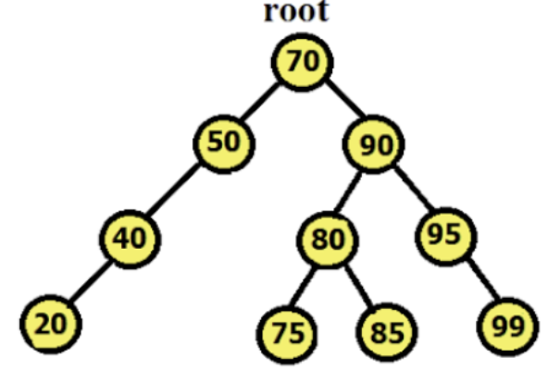
Tree Sort
Step 3: Perform in-order traversal (Left, root, right) on the tree to get the elements in sorted order.
20 40 50 70 | 75 80 85 | 90 | 95 99
Binary trees Ch 12.2–3

Slide 27
Tree Sort
Time complexity:
Complexity of each element insertion when tree is balanced is O(h) = O(logn)
Hence, the complexity of n element insertion will be O(n x logn) = O(nlogn)
Complexity of each element insertion when tree is unbalanced (skewed) is O(h) = O(n)
Hence, the complexity of n element insertion will be O(n) x O(n) = O(n^2)
Best & average case: O(n*logn), if tree nearly balanced
Worst case: O(n^2), if its is a skewed tree
Binary trees Ch 12.2–3

Slide 28
Min and Max of BST
Minimum is leftmost leaf
  (Time is O(h) = O(logn) [when balanced])
  (Time is O(h) = O(n) [when unbalanced])
Maximum is rightmost leaf
  (Time is O(h) = O(logn) [when balanced])
  (Time is O(h) = O(n) [when unbalanced])
Binary trees Ch 12.2–3

Slide 29
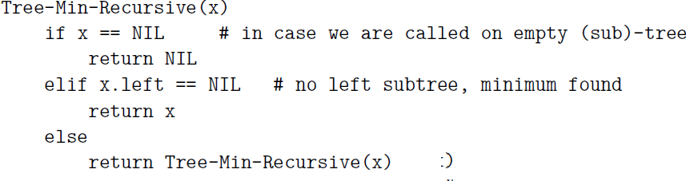
Minimum of BST
Recursive solution
This algorithm is an example of tail recursion.
Since each function call comes with an overhead,
it is often more efficient to eliminate tail recursion and replace it by a loop.
Binary trees Ch 12.2–3

Slide 30
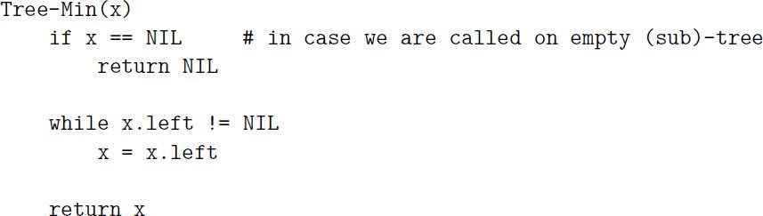
Minimum of BST
Iterative solution
Binary trees Ch 12.2–3

Slide 31
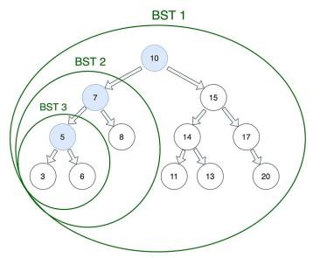
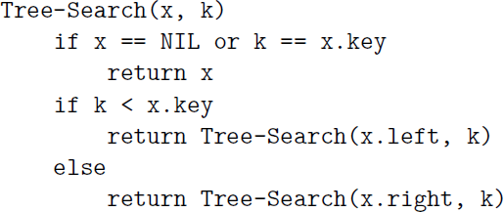
Search
Find Key=5
Time complexity is O(h) = O(logn) [when balanced],
Time complexity is O(h) = O(n) [when unbalanced],
where h is height of tree
Binary trees Ch 12.2–3

Slide 32
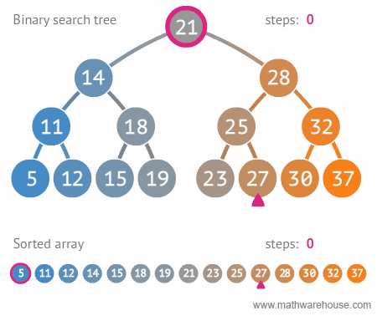
Search 27
Height of this tree is =3
In BST, comparisons/steps = 4
In array, comparisons/steps = 11
For search, BST is Better
Binary trees Ch 12.2–3

Slide 33
Try out Interactive Simulation by Visualgo.net (https://visualgo.net/en/bst)
Interactive simulations

Slide 34
The End

